Slide 1


CS-429 Introduction to Data Science
Lecture – 02
Data Distribution
Fall 2024

Slide 2
Lecture outline
Population & Sample
Data Distribution
Binomial Distribution
Normal Distribution
Poisson Distribution

Slide 3
Population and Sample
The word population immediately makes us think of the entire Pakistan population of 250 million people or the entire world’s population of 7 billion people.
In statistical inference population isn’t used to simply describe only people. It could be any set of objects or units, such as tweets or photographs, or stars.
It is denoted with N.

Slide 4
Population and Sample
A sample, is a subset of the units of size ƞ in order to examine the observations to draw conclusions and make inferences about the population.
There are different ways of sampling and we should be aware of particular sampling mechanisms because it can introduce biases into the data.
If the subset is not a representative version of the population then, any conclusions you draw will simply be wrong and distorted.

Slide 5
Population and Sample
“How much data we need depends on what our goal is”.
For analysis or inference purposes, we don’t need to store all the data all the time (sampling is a solution).
Alternatively, for serving purposes if we have to generate the correct information about a user, then we need to have all the information for that particular user.

Slide 6
Population and Sample
Bias in the data:
Even if we have access to all of Facebook’s, Google’s, or Twitter’s data corpus, any inferences we make from that data should not be extended to conclude humans beyond those sets of users, or even those users for any particular day

Slide 7
Binomial Distribution
It can be thought of as the probability of a SUCCESS or FAILURE outcome in an experiment or survey that is repeated finite times.
The binomial is a distribution type with two possible outcomes (the prefix “bi” means two, or twice).
The binomial distribution is closely related to the Bernouilli distribution.
A Bernouilli distribution is a set of Bernouilli trials. Each Bernouilli trial has one possible outcome, “success or failure”

Slide 8
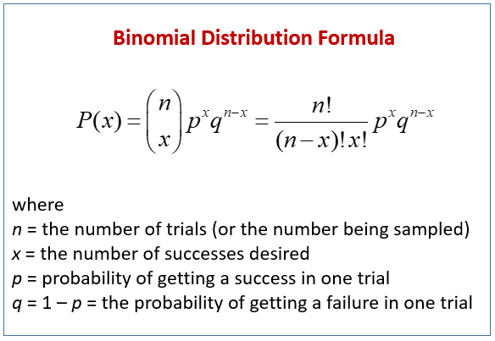
Criteria for Binomial Distribution
B ̶ “bi” means two, or twice, SUCCESS or FAILURE
I ̶ independent sample/ experiment/ result
N ̶ number of experiments
S ̶ same probability value for every outcome (success or failure)
Formula

Slide 9

Observation: Binomial Distribution
It is discrete: parameters (n and x) must be integers. There is no way of getting 101.25 heads in 200 coin tosses.
You probably can explain the theory behind it: like Pascal’s triangle
It is sort of bell-shaped: it is perfectly symmetrical, with the mean in the middle.
It is defined using only two parameters: All we need are values of p and n to completely define a given binomial distribution

Slide 10
Real Life Examples: Binomial Distribution
A coin toss has only two possible outcomes: head or tail, and doing a test could have two possible outcomes: pass or fail.
If a new drug is introduced to cure a disease, it either cures the disease (it’s successful) or it doesn’t cure the disease (it’s a failure).
If you purchase a lottery ticket, you’re either going to win money, or you aren’t.
Basically, anything you can think of, that can only be a success or a failure can be represented by a binomial distribution.

Slide 11
Example 1
A fair coin is tossed 10 times. What is the probability of getting exactly 6 heads?
The number of trials (n) is 10
x = 6
The odds of success (“tossing a head”) is 0.5
(So 1- p = 0.5)
P(X = 6) = 10C6 * 0.5^6 * 0.5^4
= 210 * 0.015625 * 0.0625
= 0.205078125

Slide 12
Example 2
80% of people who purchase pet insurance are women. If 9 pet insurance owners are randomly selected, find the probability that exactly 6 are women
The number of trials (n) is 9
x = 6
The probability of success is 0.8
(So 1- p = 0.2)
P(6) = 9C6 * 0.8^6 * 0.2^3
= 84 * 0.262144 * 0.008
= 0.176

Slide 13
Graph of bell-shape
Binomial probability mass function and normal probability distribution function approximation for n = 6 and p = 0.5

Slide 14
Normal Distribution
A normal distribution (bell curve), is a distribution that occurs naturally in many situations
For example: bell curve is seen in tests like SAT and GRE. Bulk of students will score average (C), whereas small number of students will score B or D. In addition, very small number of students will score F or A
The bell curve is symmetrical. Half of the data will fall to the left of the mean; half will fall to the right.

Slide 15
Normal Distribution Examples
Many real-life problems follow this type of pattern. It is widely used in businesses and statistics:
Heights of people.
Measurement errors.
Blood pressure.
Points on a test.
IQ scores.
Salaries.

Slide 16
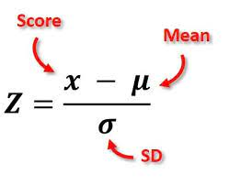
Z-score
A Z-score (or standard score) represents the number of standard deviations a data point is from the mean of the distribution.
It helps to understand how unusual or typical a data point is within a normally distributed set.
For a data point X, the Z-score is calculated as:

Slide 17
Normal Distribution (Bell-Shape)
Z-Index Value

Slide 18
Normal Distribution Covered Area
Different understanding of the “covered areas” of a normal distribution

Slide 19
Area Defined by Standard Deviations
Within 1 Standard Deviation (𝜇±𝜎):
This range covers about 68% of the data. Range from -1 ~ +1 (68.2%)
Within 2 Standard Deviations (𝜇±2𝜎):
This range covers about 95% of the data.
Range from -2 ~ +2 (95.4%)
Within 3 Standard Deviations (𝜇±3𝜎):
This range covers about 99.7% of the data.
Range from -3 ~ +3 (99.7%)

Slide 20
Normal Distribution
Plot
Sections and distribution

Slide 21
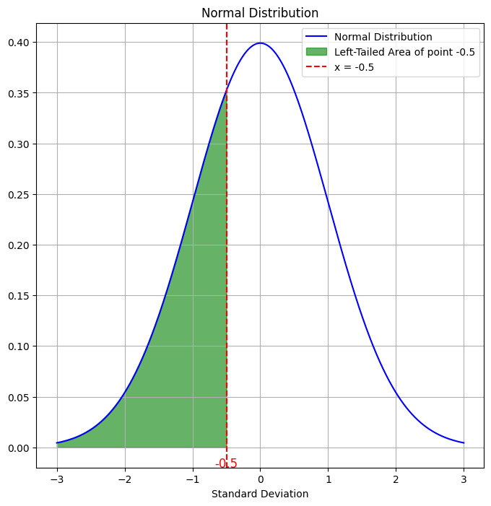
Left-Tailed and Right-Tailed Areas
Any point 𝑋 with a corresponding Z-score can be interpreted in terms of:
Left-tailed area: The area to the left of a Z-score, showing the probability of a value being less than 𝑋.
Right-tailed area: The area to the right of a Z-score, showing the probability of a value being greater than 𝑋.

Slide 22
Left-Tailed and Right-Tailed Areas (Python)
import numpy as np
import matplotlib.pyplot as plt
from scipy.stats import norm
mean = 0
std_dev = 1
x = np.linspace(mean - 3*std_dev, mean + 3*std_dev, 1000)
y = norm.pdf(x, mean, std_dev)
plt.figure(figsize=(8, 8))
plt.plot(x, y, label="Normal Distribution", color='blue')
# Define the range for the shaded left-tailed area
x_fill = np.linspace(-3, -0.5, 1000)
y_fill = norm.pdf(x_fill, mean, std_dev)
# Fill the left-tailed area up to x = -0.5
plt.fill_between(x_fill, y_fill, color="green", alpha=0.6, label="Left-Tailed Area of point -0.5")
plt.axvline(x=-0.5, color='red', linestyle='--', linewidth=1.5, label="x = -0.5")
plt.text(-0.5, -0.02, '-0.5', ha='center', color='red', fontsize=12)
plt.xlabel("Standard Deviation")
plt.title("Normal Distribution")
plt.legend()
plt.grid(True)
plt.show()

Slide 23
Middle Area Between Two Values
To find the proportion of data between two values, calculate the cumulative probabilities for each Z-score and subtract the smaller one from the larger one.
Example: Suppose we want to know the percentage of data between 𝑍=−1 and 𝑍=+1:
Find the cumulative probability for 𝑍=1.0 (about 0.84134).
Find the cumulative probability for 𝑍=−1.0 (about 0.15866).
Subtract the smaller cumulative probability from the larger: 0.84134 - 0.15866 = 0.68268 = 68.26%
So, approximately 68% of values fall between 𝑍 range −1 ~ +1.
Values from z-table

Slide 24
Example
A group of students with normally distributed salaries, earn an average of $6,800 with a standard deviation of $2,500. What proportion of students earn between $6,500 and $7,300?
Solution:
μ = 6800
σ = 2500.
a = 6500 // lower value
b = 7300 //upper value.
P(a < X < b) = P(X < b) – P (X < a)

Slide 25
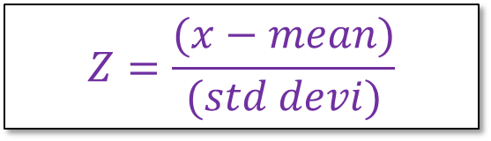
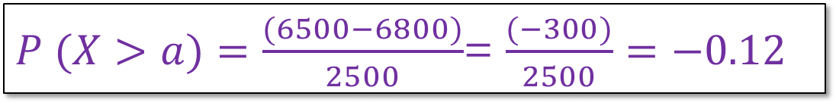
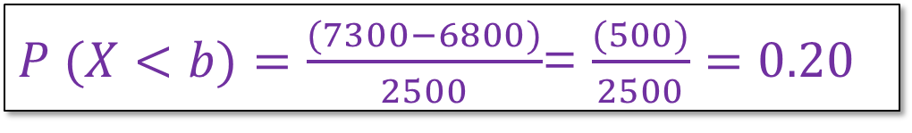
Example 2
$$Z=\frac{(x−mean)}{(std devi)}$$
Formula to find Z score:
P (X < b)
P (X > a)
P(a < X < b) = P(X < b) – P (X > a)
P(a < X < b) = 0.57926 – 0.45224 = 0.12702
12.7% of total students earn between $6500 to $7300
$P (X<b)=\frac{(7300−6800)}{2500}$= $\frac{(500)}{2500}=0.20$
Z-table value 0.57926
$P (X>a)=\frac{(6500−6800)}{2500}$= $\frac{(−300)}{2500}=−0.12$
Z-table value 0.45224
Enter Z-table value

Slide 26
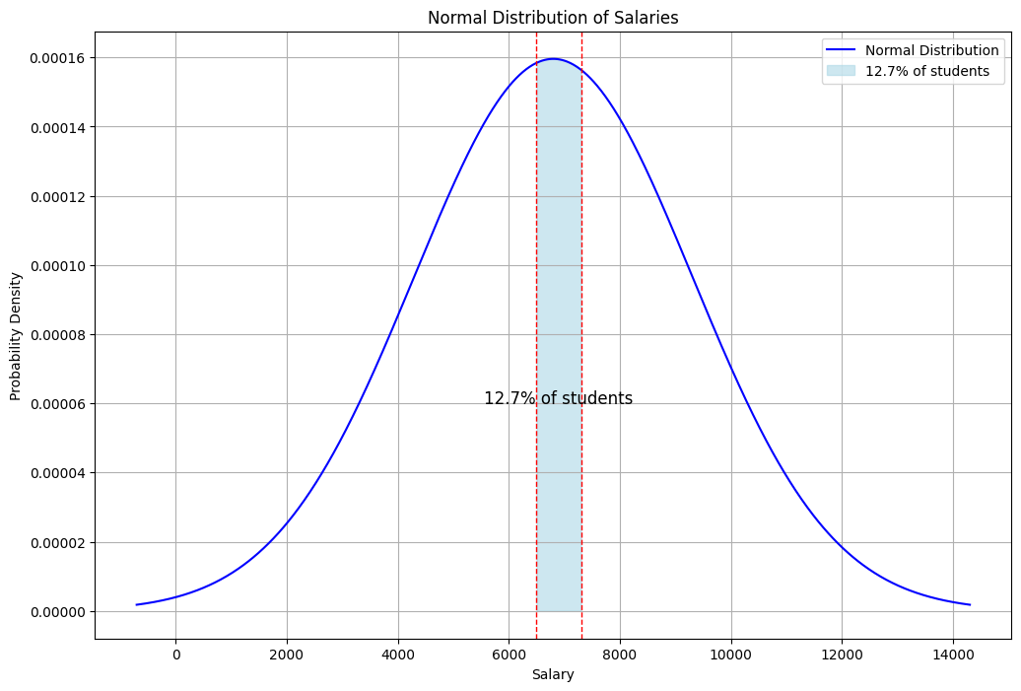
Example Plot

Slide 27
Example Plot Lab
import numpy as np
import matplotlib.pyplot as plt
from scipy.stats import norm
mean = 6800
std_dev = 2500
x = np.linspace(mean - 3*std_dev, mean + 3*std_dev, 1000)
y = norm.pdf(x, mean, std_dev)
plt.figure(figsize=(12, 8))
plt.plot(x, y, label="Normal Distribution", color='blue')
x_fill = np.linspace(6500, 7300, 1000)
y_fill = norm.pdf(x_fill, mean, std_dev)
plt.fill_between(x_fill, y_fill, color="lightblue", alpha=0.6, label="12.7% of students")
plt.axvline(6500, color='red', linestyle='--', linewidth=1)
plt.axvline(7300, color='red', linestyle='--', linewidth=1)
plt.text(6900, 0.00006, "12.7% of students", color="black", fontsize=12, ha="center")
plt.xlabel("Salary")
plt.ylabel("Probability Density")
plt.title("Normal Distribution of Salaries")
plt.legend()
plt.grid(True)
plt.show()

Slide 28
Poisson Distribution
It is a statistical distribution that shows how often an event will likely occur within a specified period.
It is used for independent events that occur at a constant rate within a given interval of time.
The Poisson distribution is a discrete function, meaning that the event can only be measured as occurring or not occurring. (Like binomial distribution – Success or failure)

Slide 29
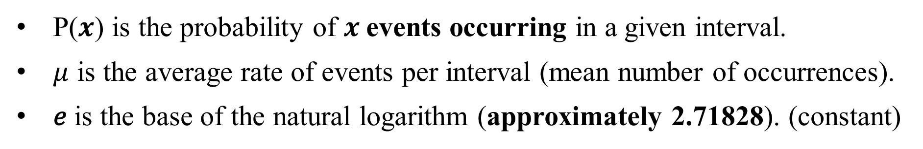
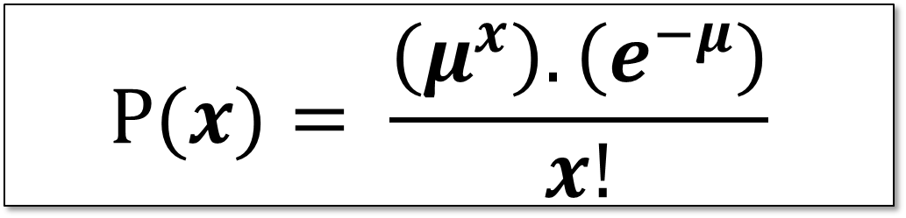
Poisson Distribution
$$P(x)= \frac{\left(μ^{x}\right).\left(e^{−μ}\right)}{x!}$$
P($x$) is the probability of $x$events occurring in a given interval.
$μ$ is the average rate of events per interval (mean number of occurrences).
𝑒 is the base of the natural logarithm (approximately 2.71828). (constant)

Slide 30
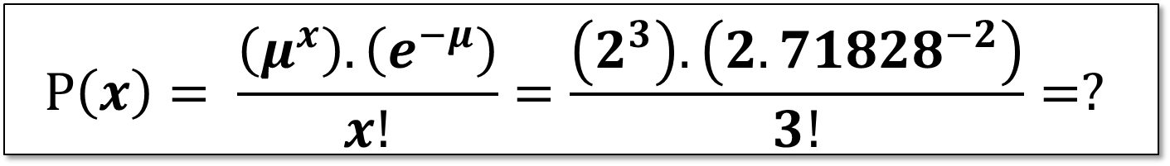
Example 1
The average number of major storms in New York City is 2 per year. What is the probability that exactly 3 storms will hit the city next year?
Solution:
μ = 2 (average number of storms per year, historically)
x = 3 (the number of storms we think might hit next year)
e = 2.71828 (natural logarithm constant)
$$P\left(x\right)= \frac{\left(μ^{x}\right).\left(e^{−μ}\right)}{x!}=\frac{\left(2^{3}\right).\left({2.71828}^{−2}\right)}{3!}=?$$
0.1804472909403099
= 18.04%

Slide 31
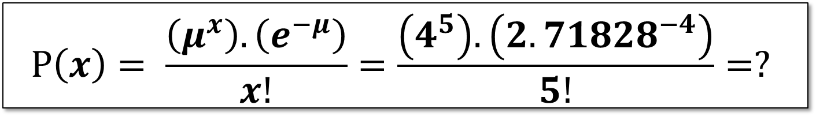
Example 2
A call center receives an average of 4 calls per minute (μ=4). Use the Poisson distribution, “What’s the probability that 5 calls come in during the next minute?”
Solution:
μ = 4 (average number of storms per year, historically)
x = 5 (the number of storms we think might hit next year)
e = 2.71828 (natural logarithm constant)
$$P\left(x\right)= \frac{\left(μ^{x}\right).\left(e^{−μ}\right)}{x!}=\frac{\left(4^{5}\right).\left({2.71828}^{−4}\right)}{5!}=?$$
0. 15629388133546667
= 15.62 %

Slide 32
Questions

Slide 33

Why Me? | Understanding Qadar with Dr. Omar Suleiman
URL: Why Me? | Understanding Qadar with Dr. Omar Suleiman | Ramadan Series 2024 TRAILER
Number of episodes: 30
Total Duration: 05 ~ 06 Hrs

